Slide 1






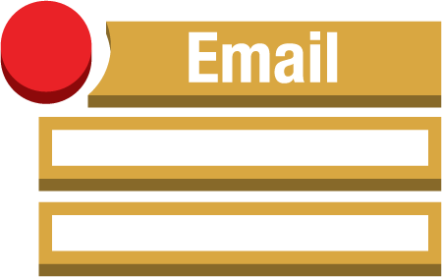



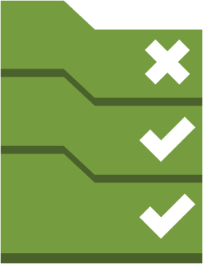
AWS Region
S3 bucket (encrypted with AWS KMS)
AWS CloudTrail
Delivered to CloudWatch Logs
Alarms
Amazon CloudWatch
Email notification
Amazon SNS
Events rules
Custom Lambda functions
Custom AWS Config rules
Lambda functions
AWS Config rules
AWS Config
Managed
Config rules

